Slide 1
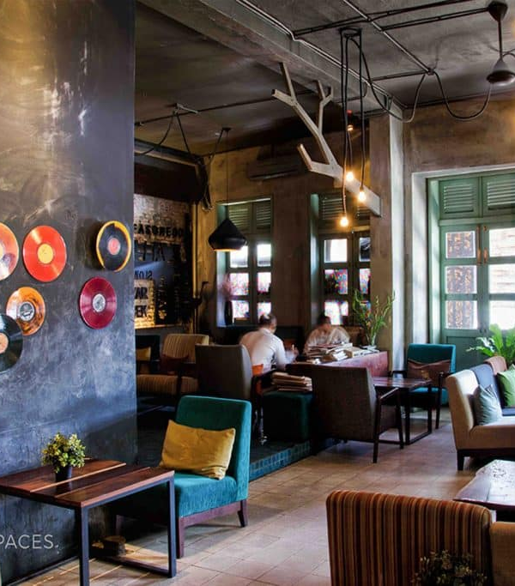
Marketing and Research Analysis Project Café Coffee Night By – Santhosh Sadasivam

Slide 2
Problem Statement and Dataset Details
Approach
Dataset : Café Coffee Night Dataset
Recommend the Café chain Owner the point which can increase the revenue of his café chain.
Recommend the owner on removing the menu items and suggesting best combos
Exploratory Analysis.
RFM Analysis
Menu Analysis via Market Basket analysis.
Recommendations

Slide 3
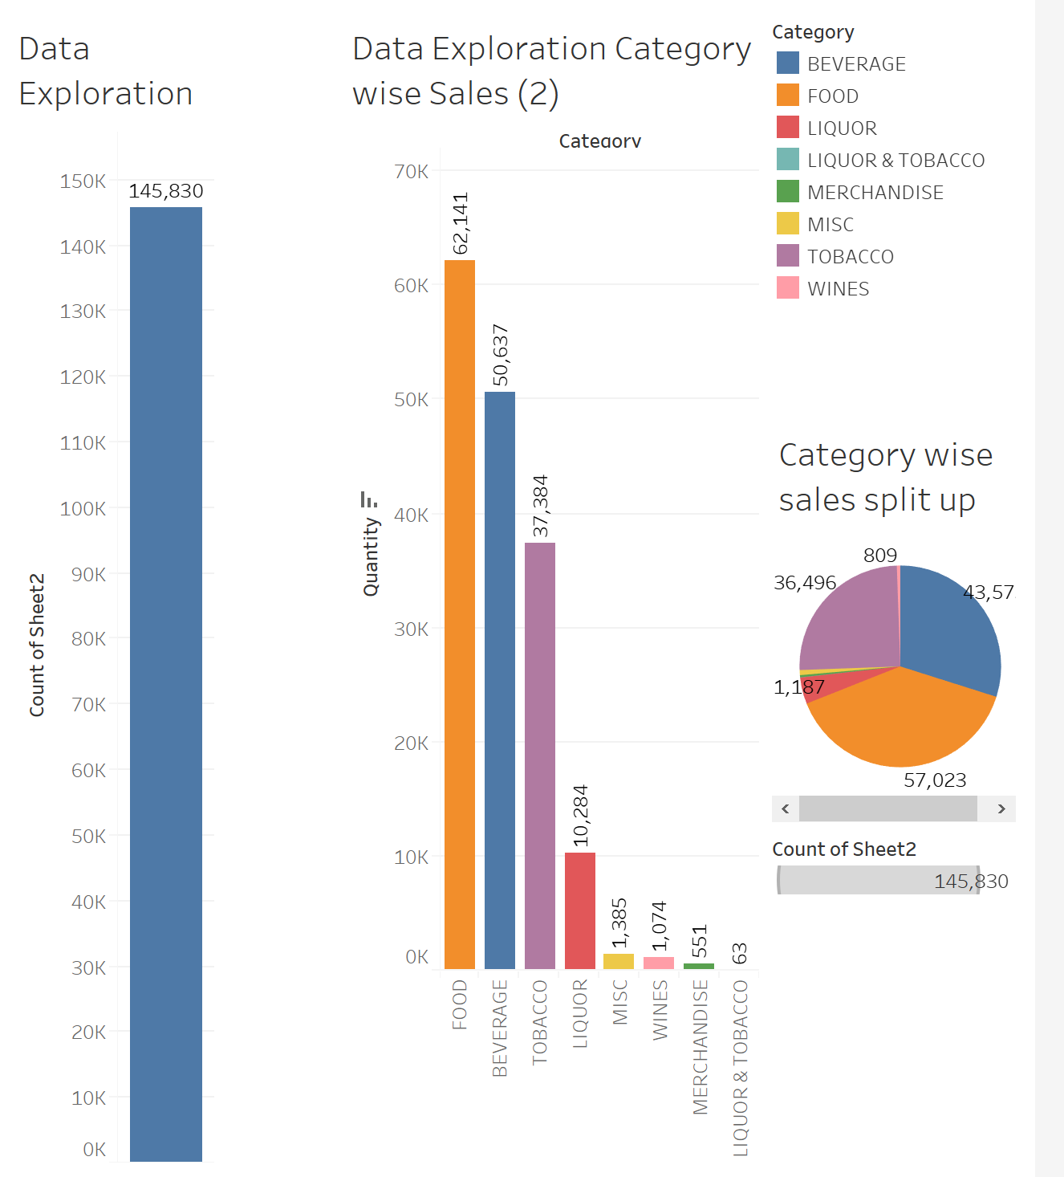
Café is open 24/7 – 365 days
There are 145830 Transactions
7 Categories of food items & 580 food items are present in the dataset
Food Items has the highest sales compared to other categories
Liquor & tobacco has the lowest sales

Slide 4
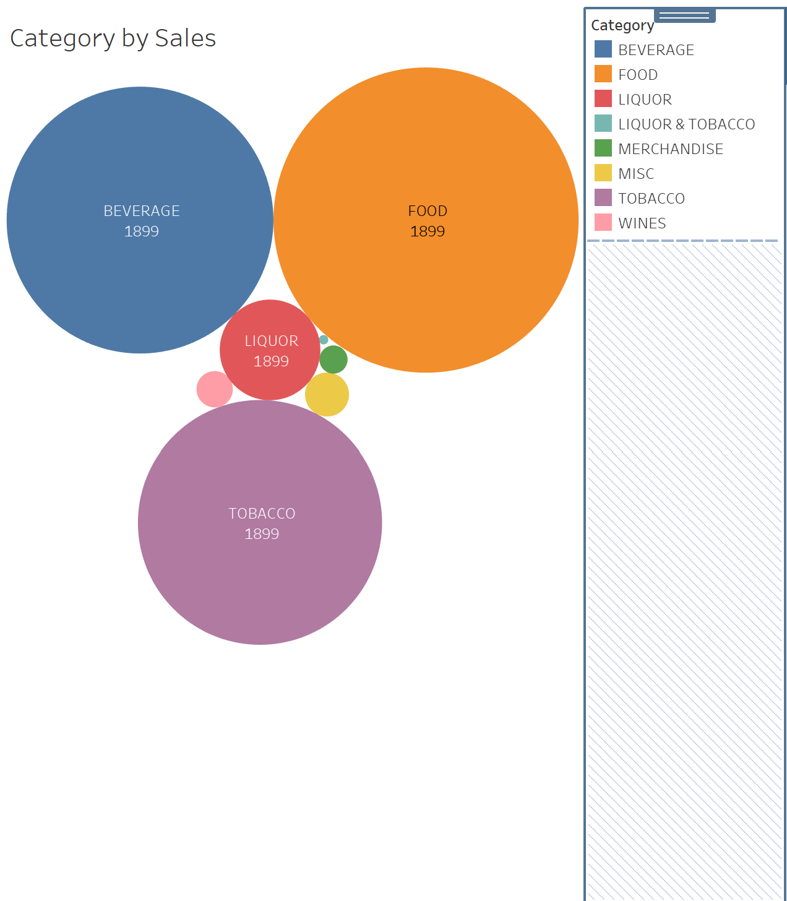
Food Category is the bulk of selling
Beverages is the 2nd highest selling category followed by Tobacco

Slide 5
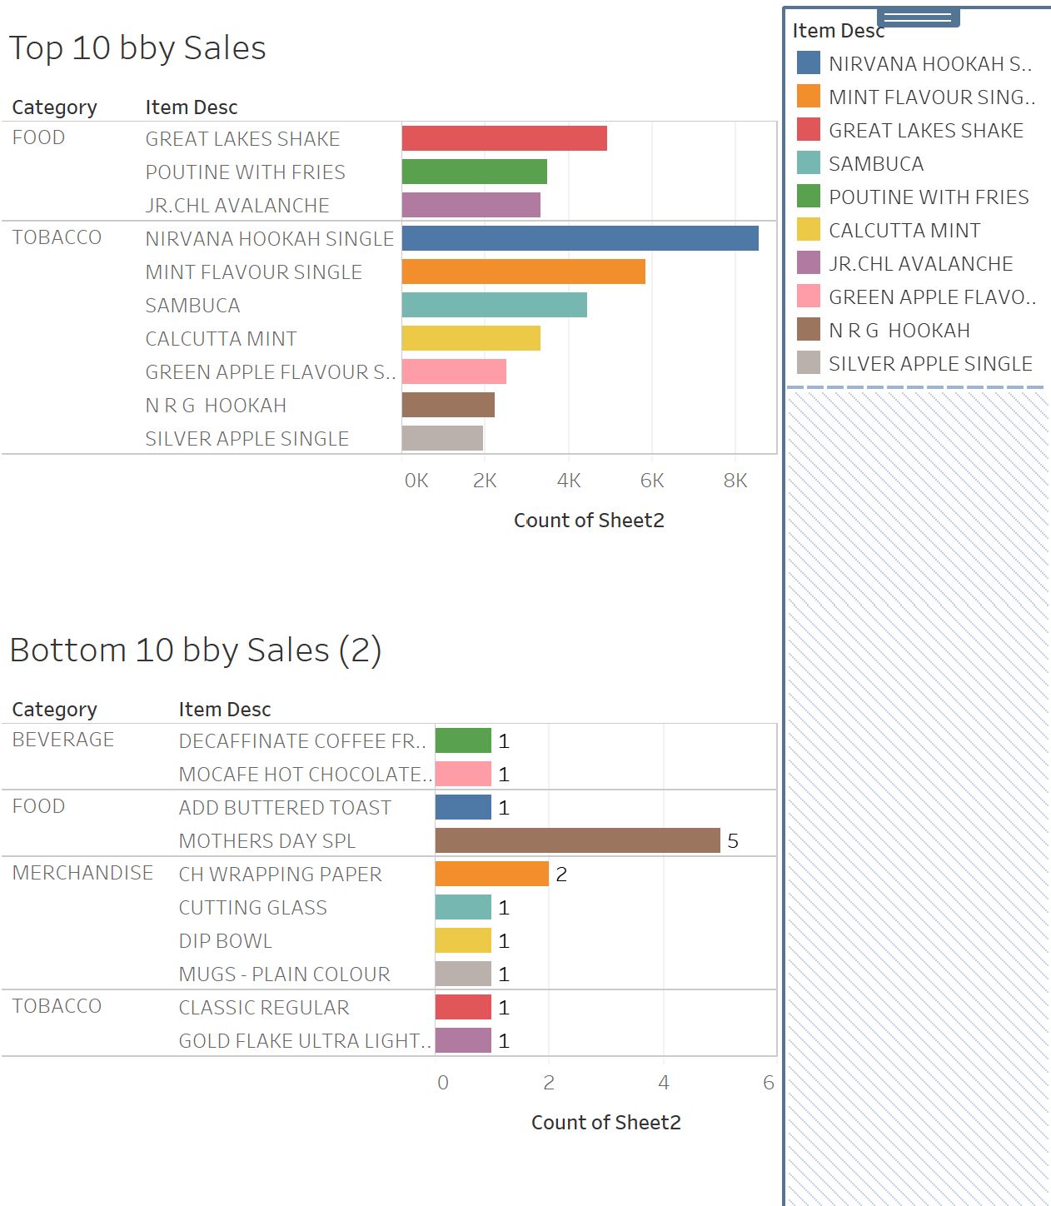
Top Selling items and their categories
Nirvana Hookah Single is the highest selling item (Category Tobacco)
Lowest Selling items and their categories

Slide 6
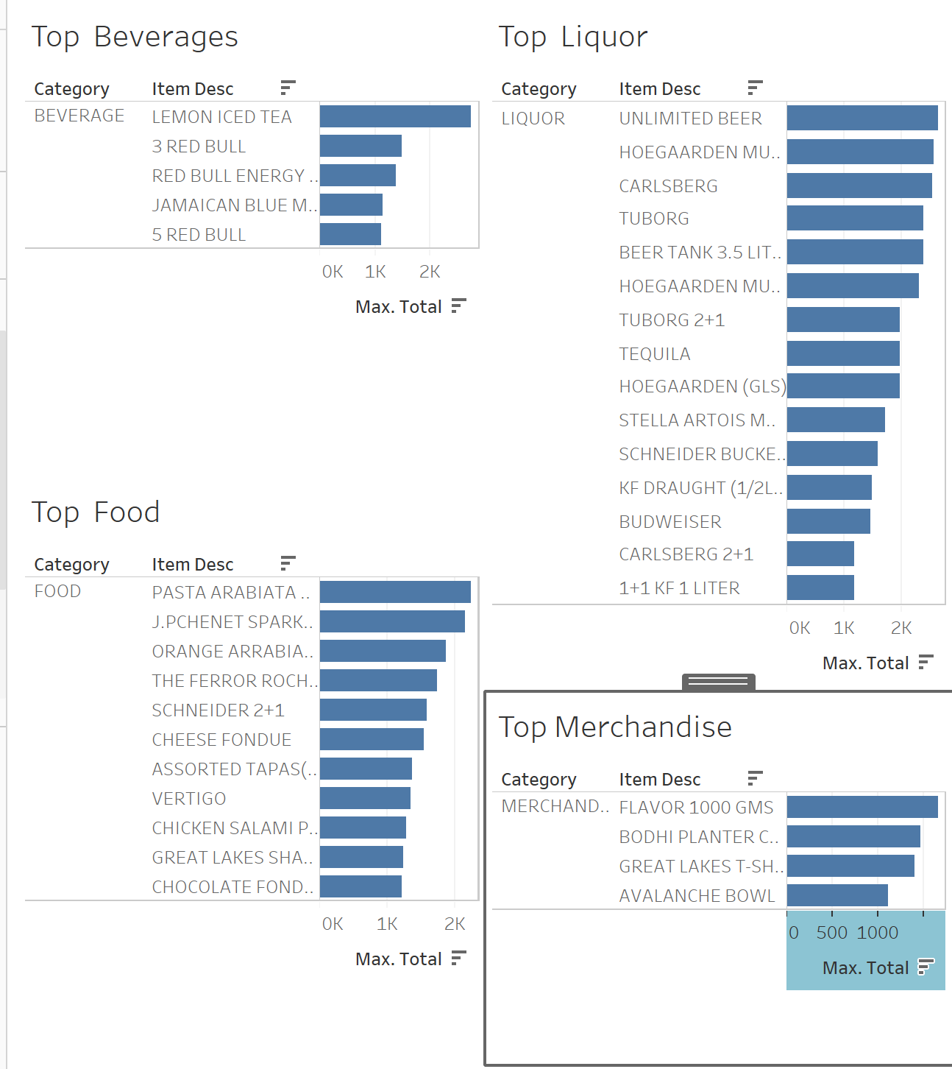
Lemon Iced Tea is the top selling item in Beverages Category
Unlimited Beer is the top selling item in Liquor Category
Pasta Arabiata is the tope selling item in Food Category
Flavor 500 GMS is the top selling item in Merchandise Category

Slide 7
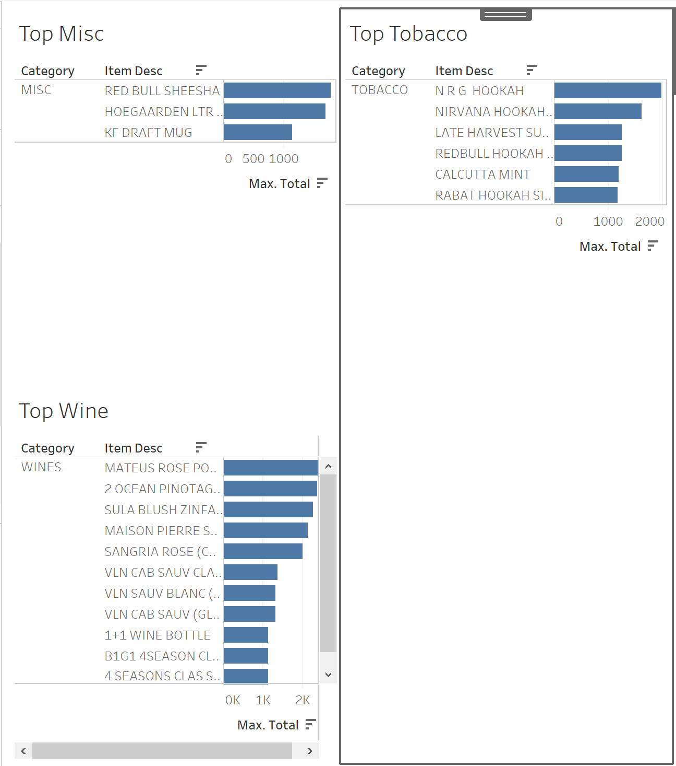
NRG Hookak is the tope selling item in Tobacco Category
Red Bull Sheesha is the top selling item in Miscellaneous Category
MATEUS ROSE PORTUGAL(BTL) is the tope selling item in Wine Category

Slide 8
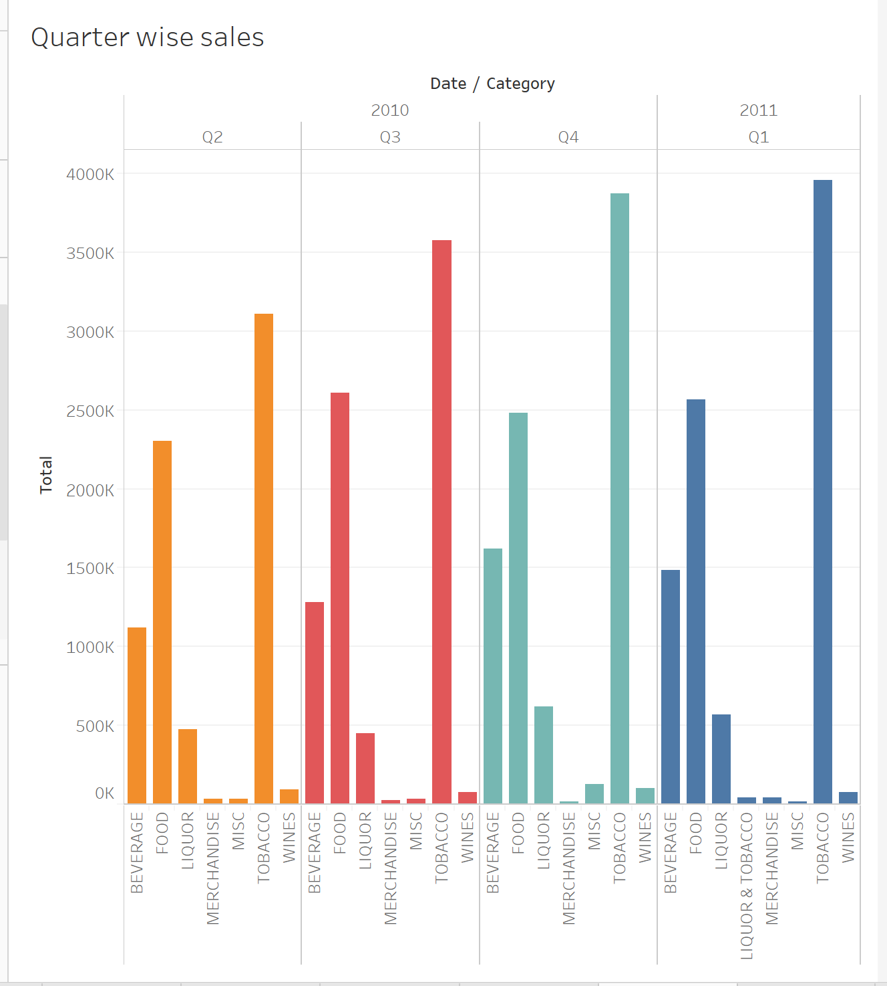
Quarters Q4 & Q1 have higher sales compared to Q2 & Q3
Sales of Tobacco is high across the quarters

Slide 9
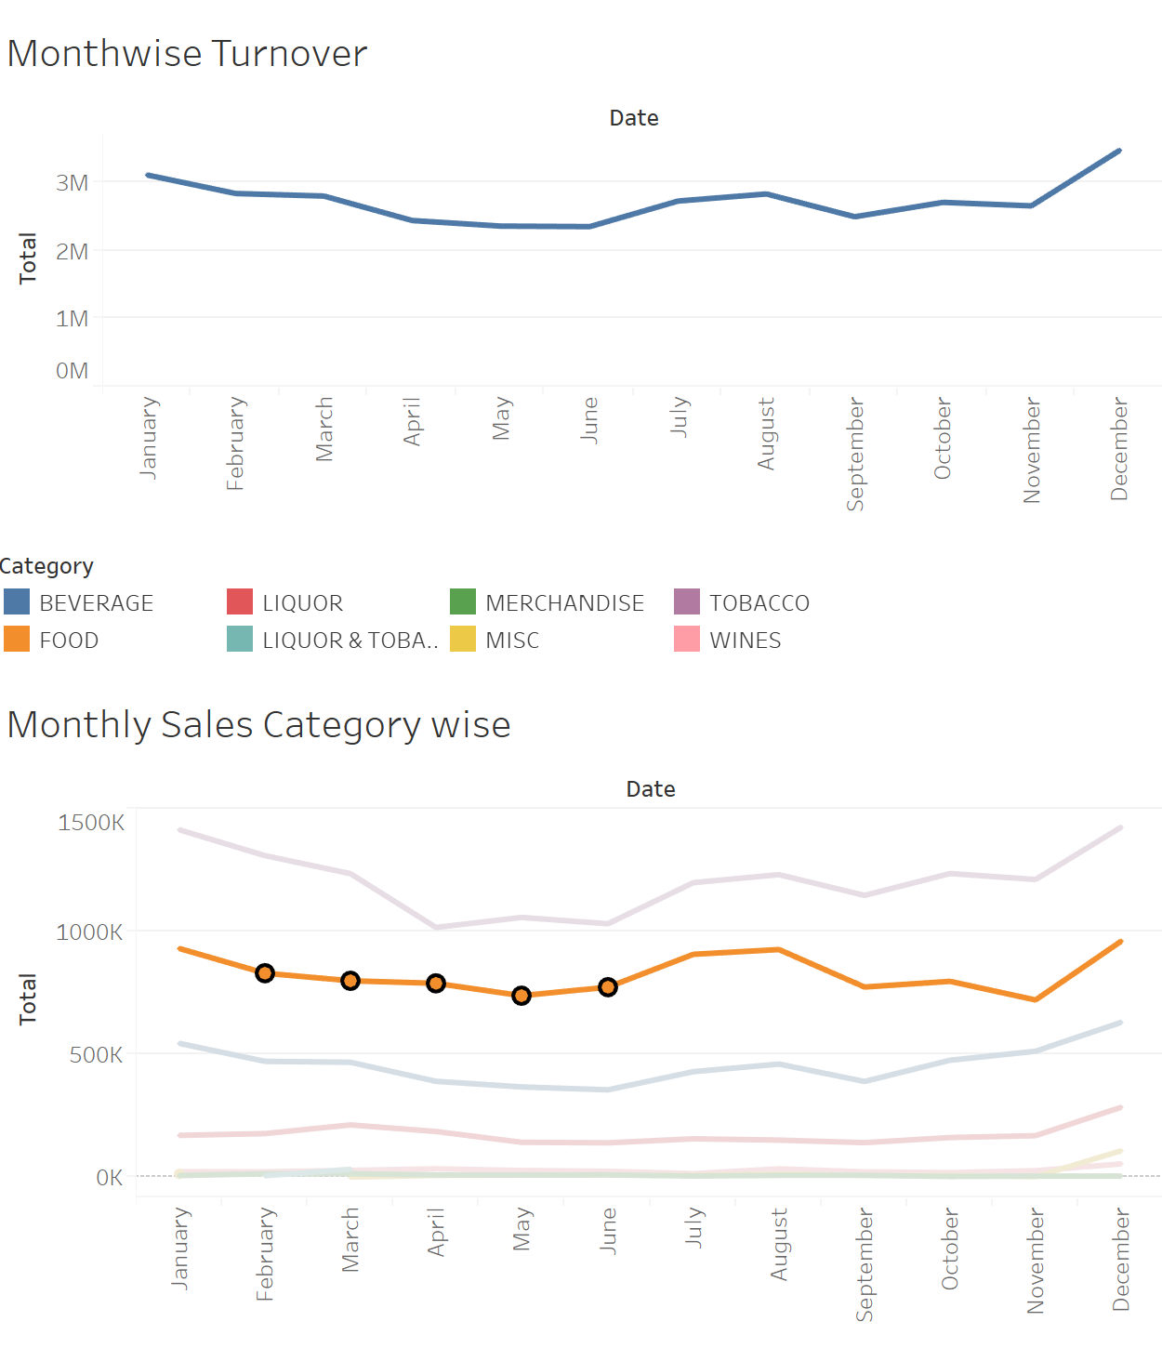
The sales is at the highest level in December. It could be for the holiday season
The sales is low in the month of June
Even in Category wise sales the same trend follows

Slide 10
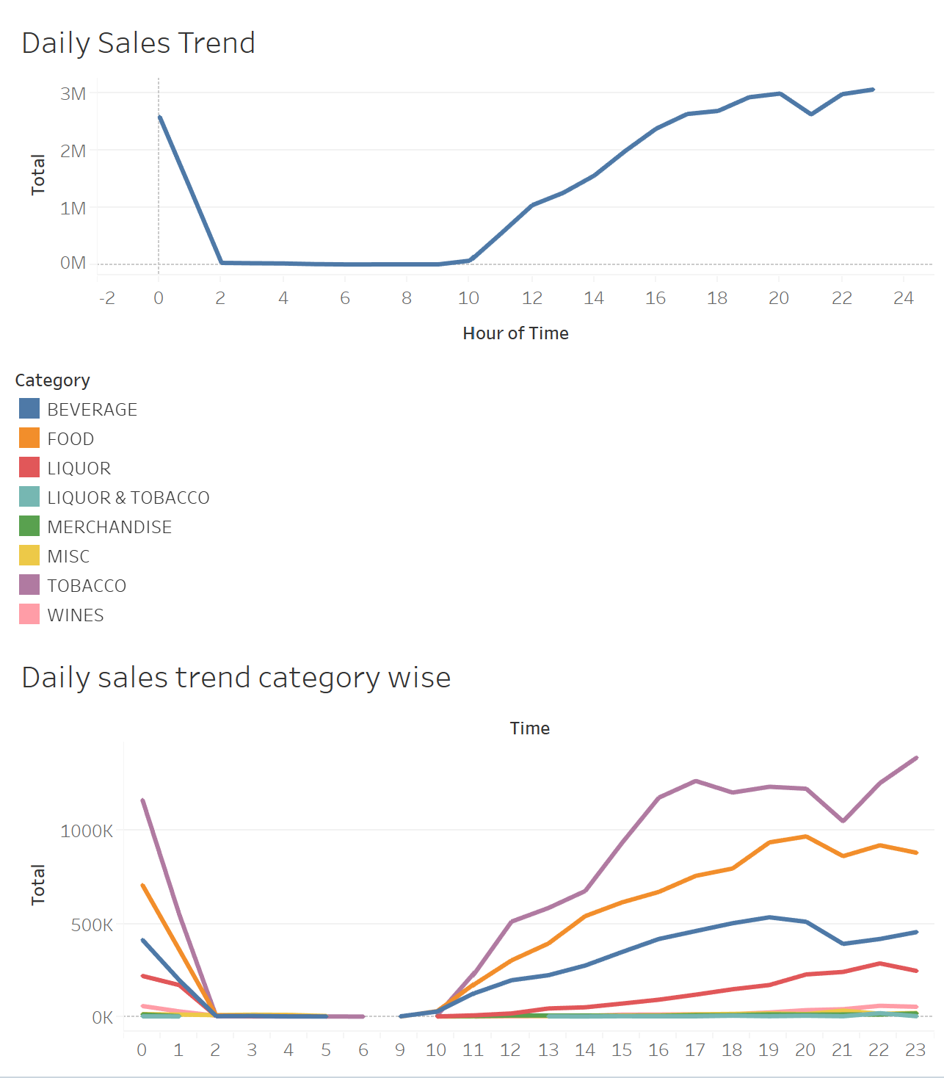
The sales is high during the afternoon and evening compared to morning
The sales is down during the morning between 3 AM – 11 AM
Sales is extremely high during Midnight

Slide 11
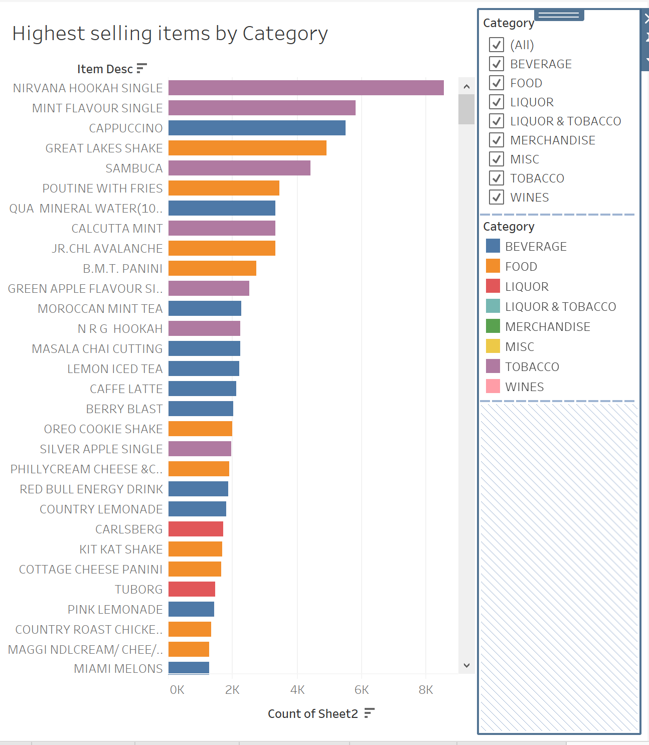
Nirvana Hookah Single is the highest selling item in Tobacco
Cappuccino is the highest selling item in Beverages
Great Lakes Shake is the highest selling item in Food
Carlsberg is the highest selling item in Liquor

Slide 12
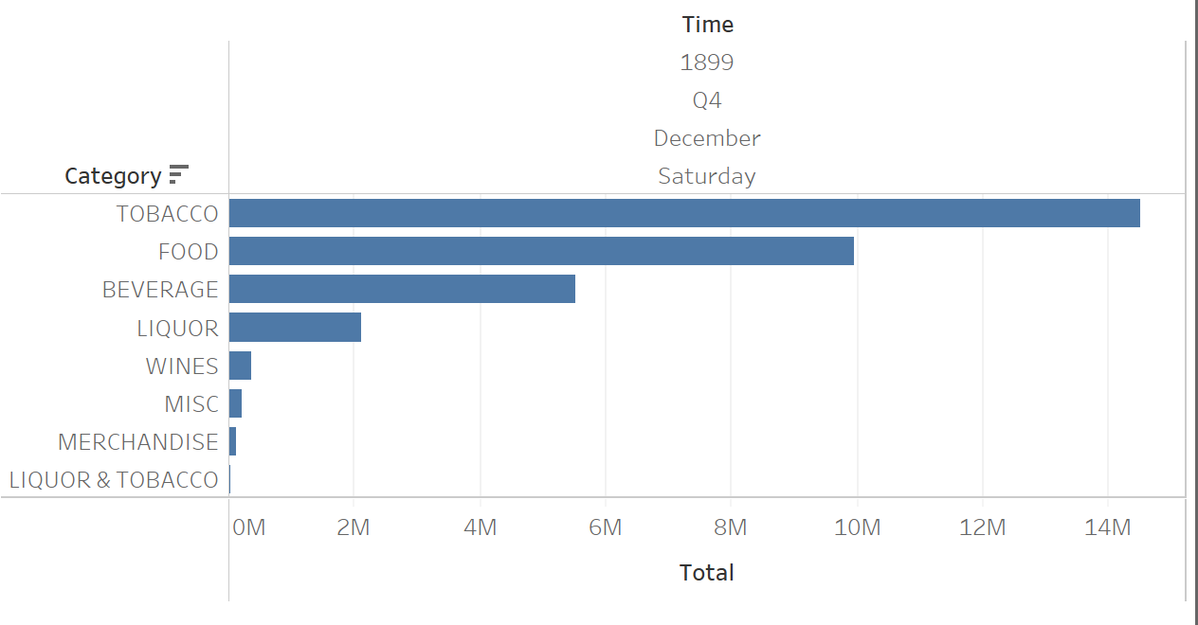
Trend of Sales across categories on a random day

Slide 13
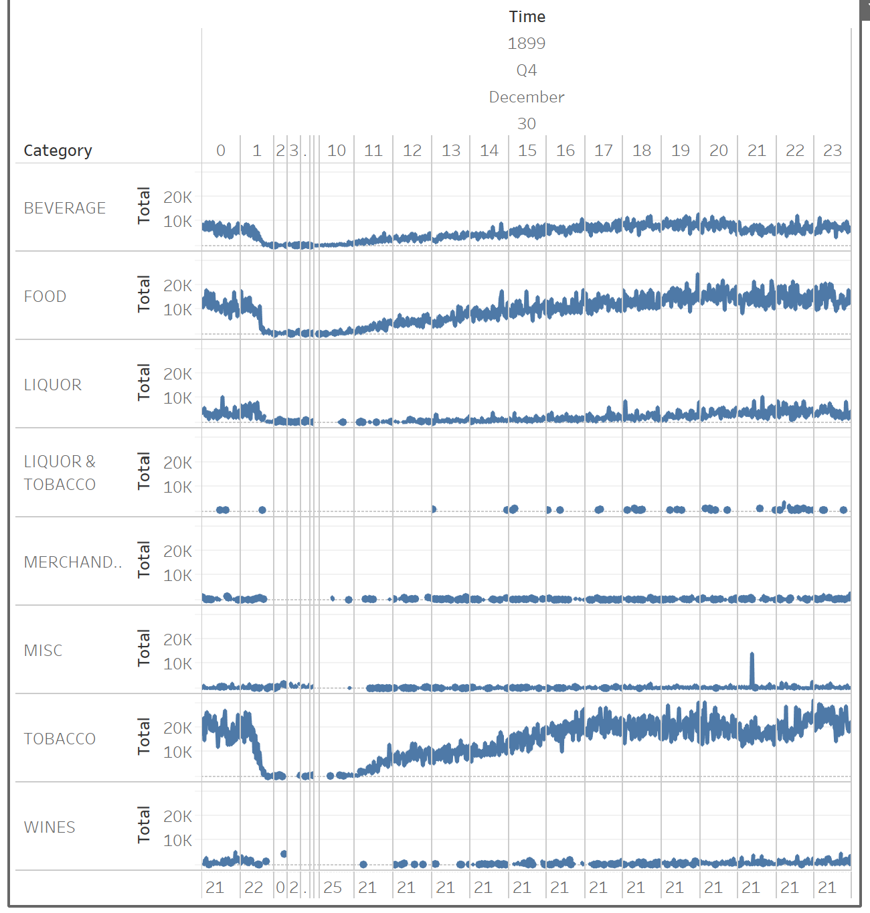
Trend of Sales across categories
Sales by Category for a particular day shows that Tobacco, Food, Liquor and Beverages sell more than other categories

Slide 14
Analysis Through RFM
Items with high Monetary Value
NIRVANA HOOKAH SINGLE
SAMBUCA
MINT FLAVOUR SINGLE
CALCUTTA MINT

Slide 15
Recommendation of removal or menu items / Corrective action required
Merchandise
Merchandise
Food
AU LAIT SET
BEACH GREEN
CH COASTER SET OF 4
COUNTRY LEMONADE GLASS(HANSA)
CUTTING GLASS
DAAKU SHOT GLASSES S-O 2
DAARU BEER GLASS
DHARMATEA LIGHT HOLDER
DIP BOWL
GUERILLA COOL
HH COOL
JAIPUR LILY
JAISALMER LILY
JODHPUR LILY
KONKAN STRIPE
MADIBA COOL
MODEL-P (IRON ASHTRAY)
MUGS - PLAIN COLOUR
MUGS - TOP BOTTOM
NAPKIN STAND
PROFESSOR COOL
SHAKE GLASS
ZEN ROCK SQUARE VASE
BEANS NACHO CHILLI W MEAT
CALAMARI FRITO
CAPONATA
CARROT CAKE
MOTHERS DAY SPL
NIRVANA HOOKAH DOUBLE
Misc
Beverages
Liquor
2 AXE TWIST
DECAFFINATE COFFEE FRAPPE
MOCAFE HOT CHOCOLATE(SF)
STELLA ARTOIS
ZINZI WHITE (BTL)

Slide 16
Recommendation of removal or menu items / Corrective action required
Wines
1 AXE TWIST
ADD CHICKEN BACON
ADD GROUND MEAT
MANGO FLAVOUR SINGLE
MINT FLAVOUR DOUBLE
1+1 VLN CAB SAUV (BTL)
1+1 VLN SAUV BLANC (BTL)
4 SEASONS CLAS SAUV(GLS
4 SEASONS CLAS SYRAH(BTL)
4 SEASONS CLAS SYRAH(GLS)
B1G1 4SEASON CLAS SAUV(BTL)
B1G1 4SEASON CLAS SAUV(GLS)
B1G1 4SEASON CLAS SYRAH(GLS)
MANDALA VALLEY CHENIN BLANC(GL
MANDALA VALLEY RED ZINFANDEL(G
SULA CHENIN BLANC (BTL)
MISC
AL SIKANDARI HOOKAH DOUBLE
APPLE FLAVOUR DOUBLE
CLASSIC MENTHOL
CLASSIC MENTHOL RUSH
CLASSIC REGULAR
GOLD FLAKE LIGHTS-BIG
GOLD FLAKE ULTRA LIGHTS(20)
GREAT LAKES HOOKAH SINGLE
ICE SPICE SHEESHA
INDIA KINGS OCEAN BLUE
GREAT LAKES ORGANISER
Tobacco

Slide 17
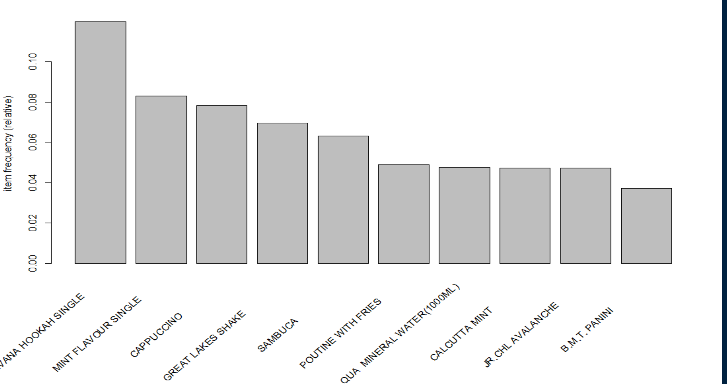
Market Basket Analysis – Frequently bought items

Slide 18
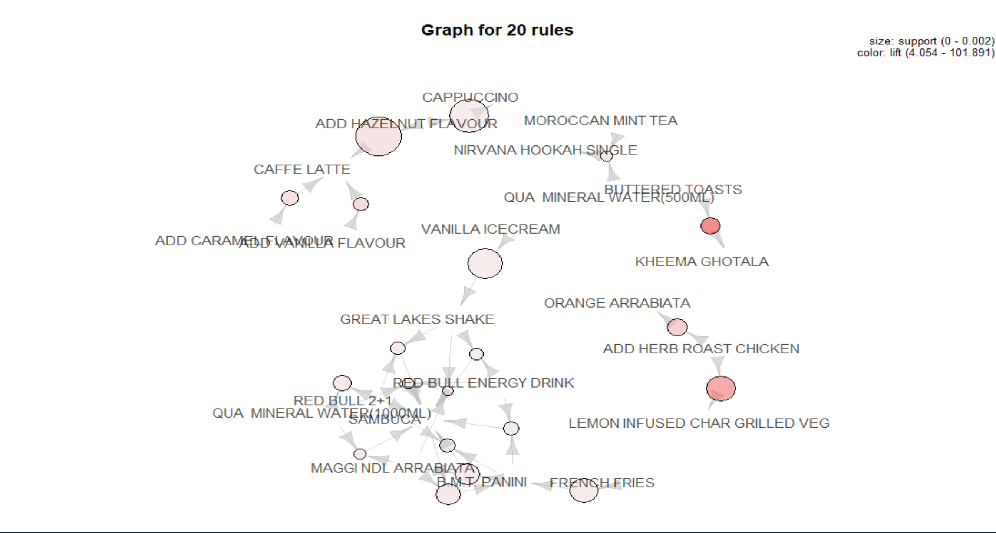
Market Basket Analysis - Graph of Rules

Slide 19
Market Basket Analysis – Suggested Combos
As per our MBA analysis these top items are brought together frequenty and hence we suggest the below combos
N R G HOOKAH And 2 RED BULL
RED BULL, PASTA ALFREDO VEG And BEER HOOKAH
{SAIGON NOODLES And ADD CHICKEN
MUSHROOM And CHEDDAR CHEESE
ADD CHICKEN And MAC N CHEESE
CHICKEN SALAMI And CEASAR SALAD BOWL
CHEDDAR CHEESE And MASALA OMELETTE

Slide 20
Recommendations and Conclusion
Provide happy Hours offers during daytime to increase revenue from Liquor category. Introduce breakfast combo to bring in more customers during that time
Tobacco is highest selling so we can give goodies of less selling products in combo with the tobacco products top up sales also minimizing wastage
Combine the food items in combo as shown in previous MBA and give combo offers.
Items doesn’t contain the breakfast items. We can include those items to run café full during those hours. It is really empty those hours. Or give more discount during that period
Recommended to lower the price during weekdays through discounts and mark it up on the weekend
Combine merchandise items with other high selling products also can give merchandise as a membership or customer loyalty badge for customer.
Increase number of employees on weekends night hours to provide better service.
Combine high selling items with any low selling items to increase the sales.
Give Buy one get one offers on Beverage items as many of them are frequently bought together
Implement these recommendations and evaluate after 2-6 months to see the performance

Slide 21


